Slide 1
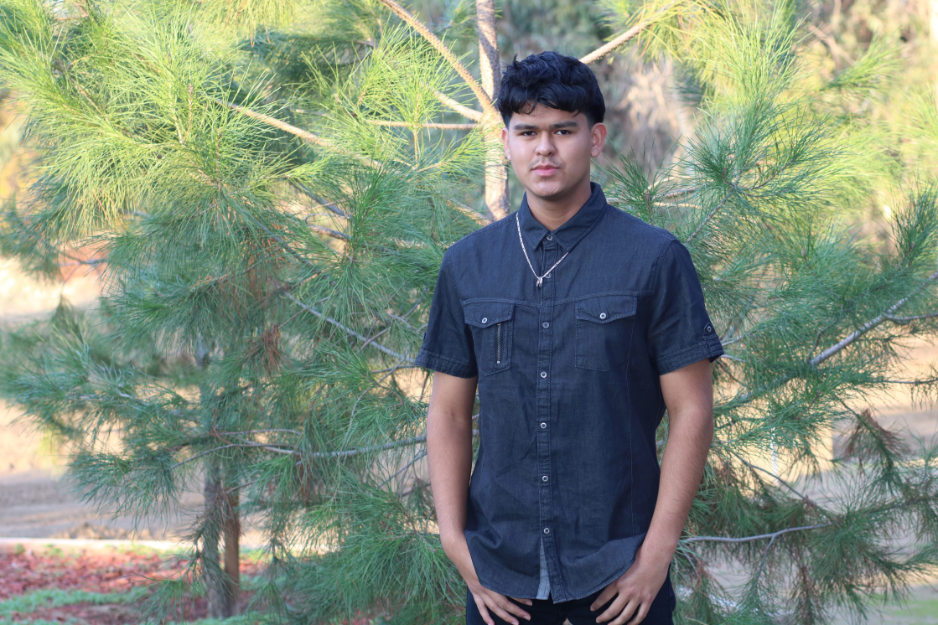
Jose Pizano

Slide 2
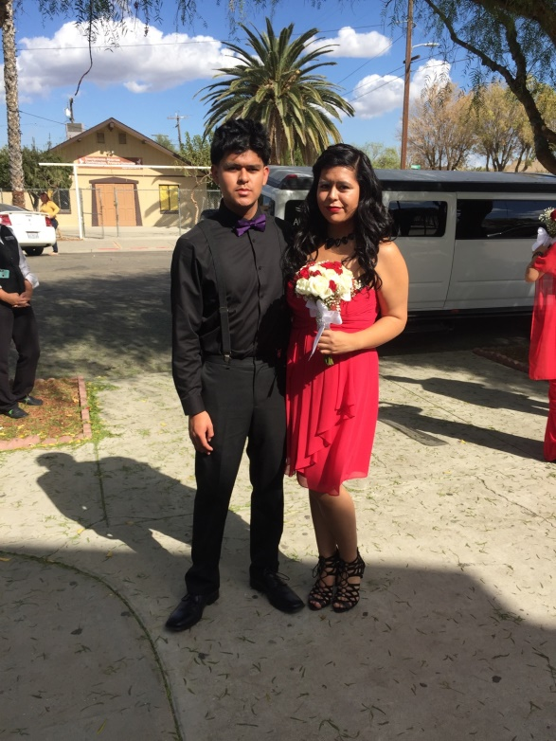
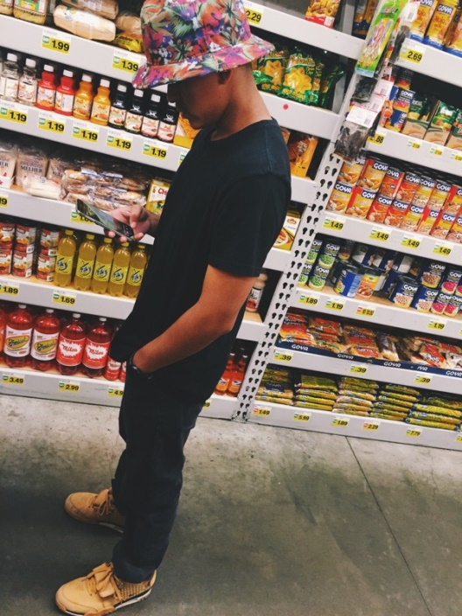
About me
Born and raised in Lindsay, California
Youngest sibling of two; I have one older sister
I have received no financial help while in high school

Slide 3
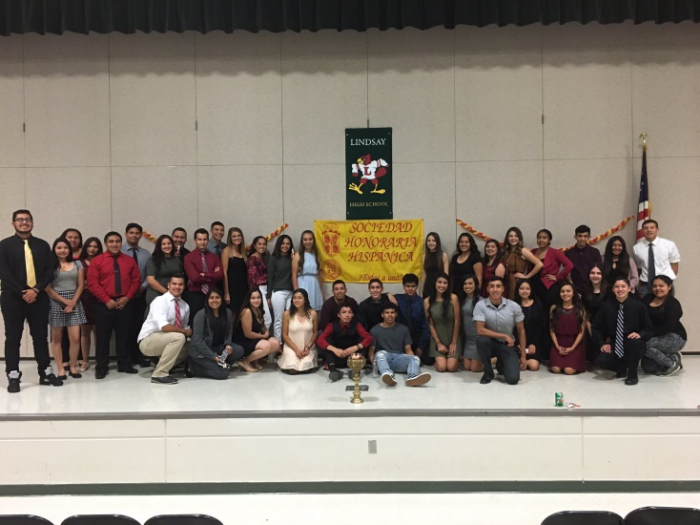
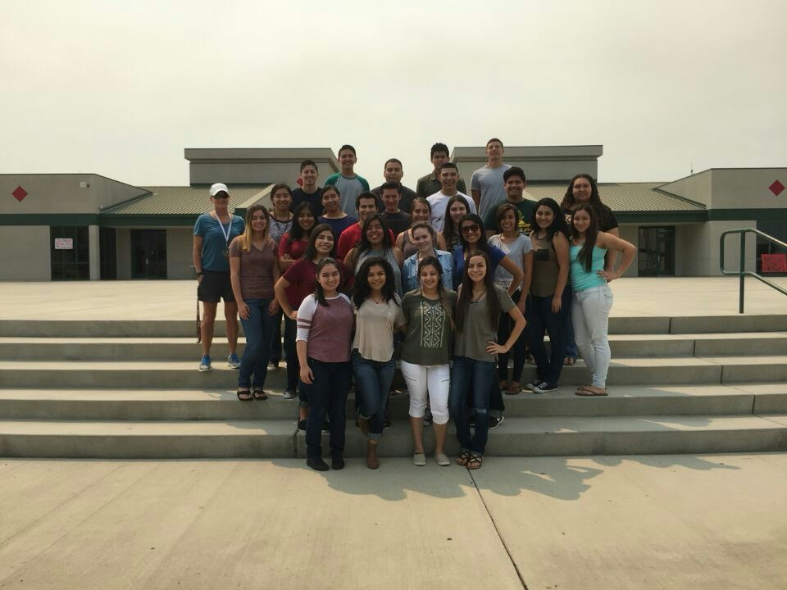
High school experience
Prominent Clubs
AVID
National Spanish Honors Society
FBLA
REAP
CSF
Proficient in Academics
PBS system taught me how to be responsible

Slide 4
Job shadow
Cynthia Gomez – Manager/Financial Manager
Monte Vista and Delta Vista apartment complexes
Financial aspect interesting

Slide 5
Pathway
Spanish Language – chose this pathway due to poor planning as a Freshman
Biliteracy is important to business
Taught me the advantages of having two languages at your disposal

Slide 6
Post-high school plans
I will attend a 4 year university: Business Administration Major
Top Choices: CSU San Jose, UC Riverside
Little financial help

Slide 7
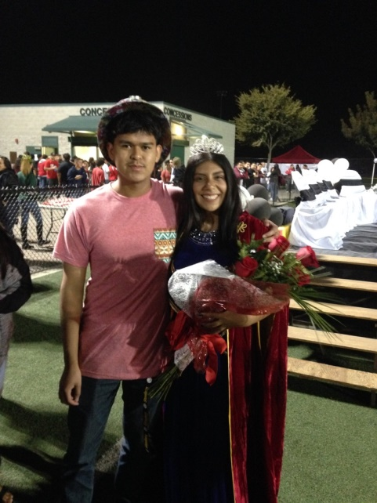
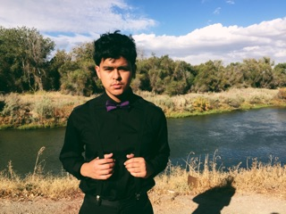
Leaving Lindsay high School
Lindsay High School has shaped me into a more confident person
Influential teacher: Mr. Guss
PBS has taught me the values of life beyond the educational aspect
Have fun

Slide 8
Any Questions?

